Slide 1
2023-01-11
(Now that I started this ISO8601 thing, I have to commit to the bit.)

Slide 2
7.5
Search Algorithms

Slide 3
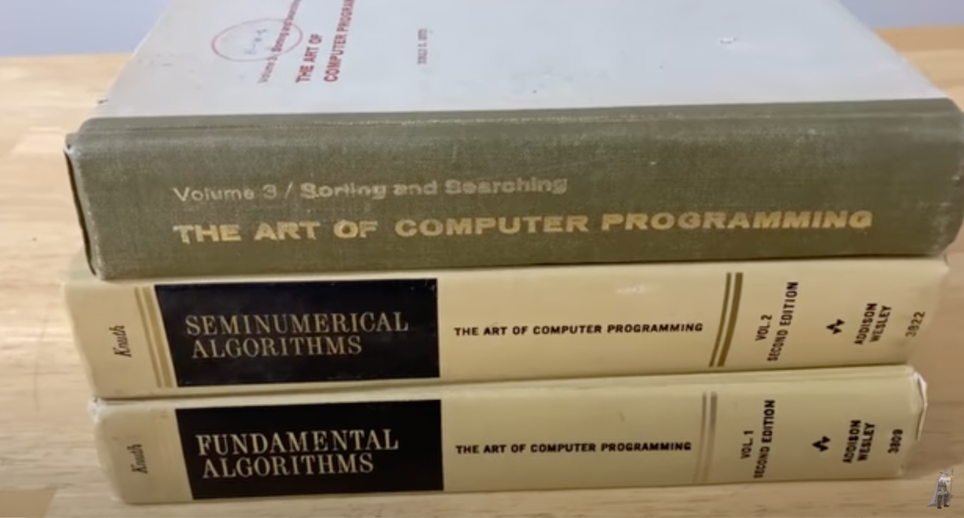

Slide 4

2018

Slide 5
Sorting and Searching
In the next few lectures, we’ll introduce algorithms for searching and sorting.
Computer scientists write code to sort and search on a daily basis – using some of the algorithms that we'll see today.
Today we will cover searching–how to efficiently determine whether an array contains a given element
Friday and Monday: we will cover our first sorting algorithms–ordering an array in an ascending or descending fashion

Slide 6
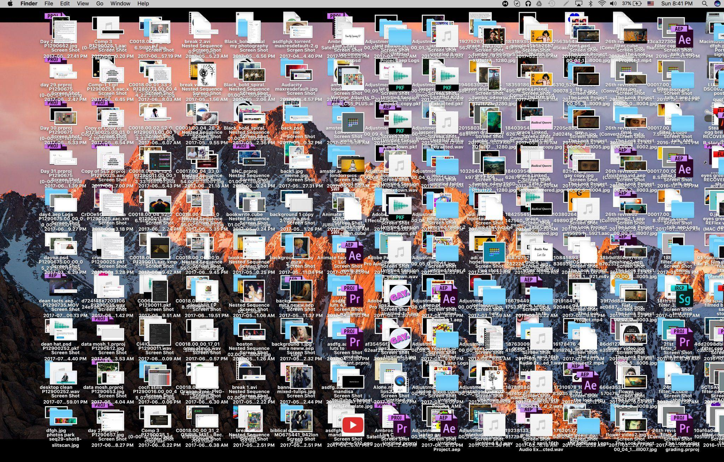


Searching
What are some strategies you use to find the item you’re looking for?

Slide 7
Sequential Search (aka Linear Search)
Steps:
Start at the first item in the list
Check if that item is the item you are looking for
If the item is the item you are looking for, you’re done!
If it is not the item and there are more items in the array, go to the next item and repeat step 2
If you have reached the end of the list, the item is not in the list

Slide 8
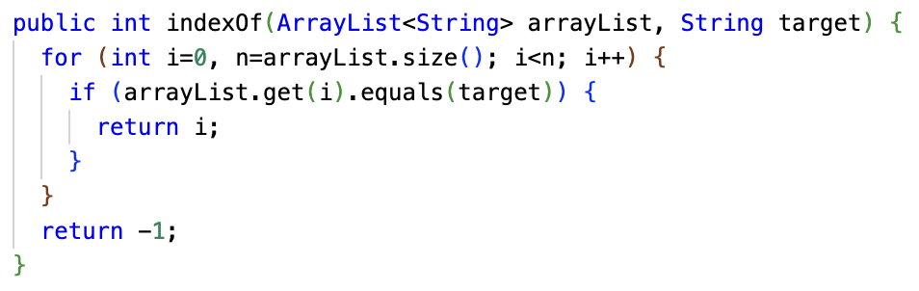
Implementing Sequential Search
Sometimes the index of the target item is what's desired.
The String.indexOf method we know and love is a sequential search.

Slide 9
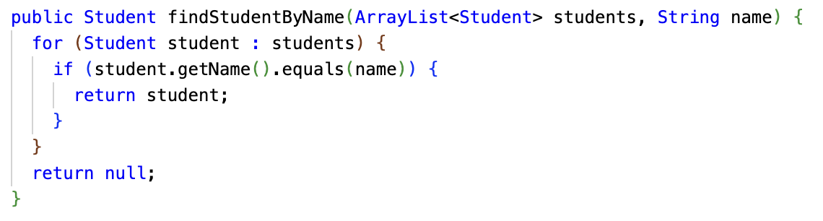
Implementing Sequential Search
You may be searching for an object that matches some criteria, and you may want the object, and not need the index.

Slide 10
Sequential Search
Pros:
You can search for an item in any unsorted list and it is guaranteed to be found if it exists in the array
Cons:
If you’re searching a long list, this can be a very slow approach
It can create performance issues even if you're searching a short list very frequently (like a list of monsters every "tick" of a video game)
Sometimes, the data structures that you're using leave you no other option but sequential search.
Sometimes, it's fast enough for the data you're searching. At other times, it may indicate that you need to change your data structures!

Slide 11
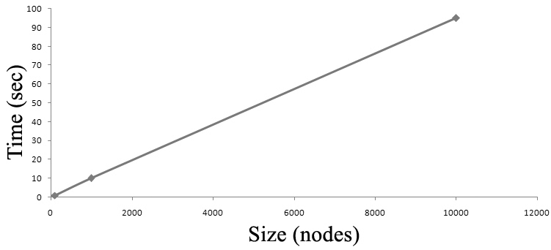
Sequential Search
If your list contains N elements, and the target element is at a random position in the list then on average it will take N/2 checks to find your element. When the time an algorithm takes to complete is directly related to the size of the array (N), we call this algorithm linear and the notation is O(N).

Slide 12
Can you think of a faster search algorithm?
As of November 2022, there were over 1.14 billion websites on the Internet.
If Google used a linear algorithm, it would take years to find results to your search queries!

Slide 13
Binary Search: Divide and Conquer
Binary search is a much faster algorithm, but requires that the list be sorted.
We can use the fact that the list is sorted to reduce the problem to smaller problems.
An algorithm that breaks the problem into smaller sub-problems is called a divide-and-conquer algorithm.
1
3
6
7
9
12
13
16

Slide 14
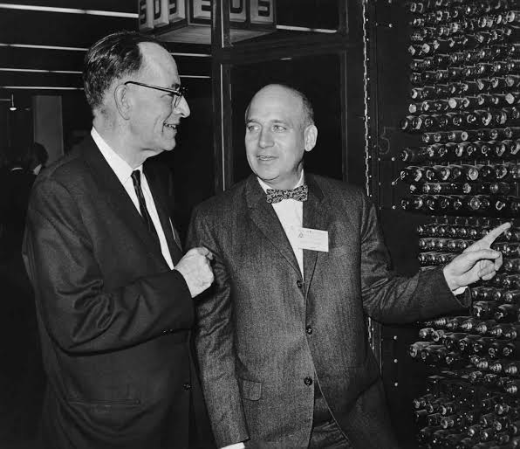
Binary Search: OK Boomer
In 1946, John Mauchly made the first mention of binary search as part of the Moore School Lectures, a seminal and foundational college course in computing.^{[9]} In 1957, William Wesley Peterson published the first method for interpolation search.^{[9][57]} Every published binary search algorithm worked only for arrays whose length is one less than a power of two^{[i]} until 1960, when Derrick Henry Lehmer published a binary search algorithm that worked on all arrays.^{[59]}
John William Mauchly (August 30, 1907 – January 8, 1980) was an American physicist who, along with J. Presper Eckert, designed ENIAC, the first general-purpose electronic digital computer, as well as EDVAC, BINAC and UNIVAC I, the first commercial computer made in the United States.

Slide 15
Binary Search: Steps
Find the index of the element 13 in the array if it exists, otherwise return -1
Step 1: Find the middle
Step 2: Check if the middle element is equal to the target element
1
3
6
7
9
12
13
16
Low Index: 0
High Index: 7
1
3
6
7
9
12
13
16

Slide 16
Binary Search: Steps
Step 3: If the element is greater than the middle element, eliminate all items to the left of the middle element, otherwise eliminate all items to the right
Repeat Step 1: Find the middle of the remaining elements
1
3
6
7
9
12
13
16
Low Index: 4
High Index: 7
1
3
6
7
9
12
13
16

Slide 17
Binary Search: Steps
Repeat Step 2: Check if the middle element is equal to the target element
Repeat Step 3: If the element is greater than the middle element, eliminate all items to the left of the middle element, otherwise eliminate all items to the right
1
3
6
7
9
12
13
16
1
3
6
7
9
12
13
16
Low Index: 6
High Index: 7

Slide 18
Binary Search: Steps
Repeat Step 1: Find the middle of the remaining elements
Repeat Step 2: Check if the middle element is equal to the target element
Step 4: Return the index of the the target element, or return -1 if the target element is not found
1
3
6
7
9
12
13
16
1
3
6
7
9
12
13
16

Slide 19
Binary Search
To find 13 in the array, it took 3 comparisons (also known as probes)
1
3
6
7
9
12
13
16

Slide 20
Binary Search
If the number of elements (N) in the array were doubled where N = 16, how many comparisons would you need to find 13?
1
3
6
7
9
12
13
16
21
23
26
27
29
32
33
36

Slide 21
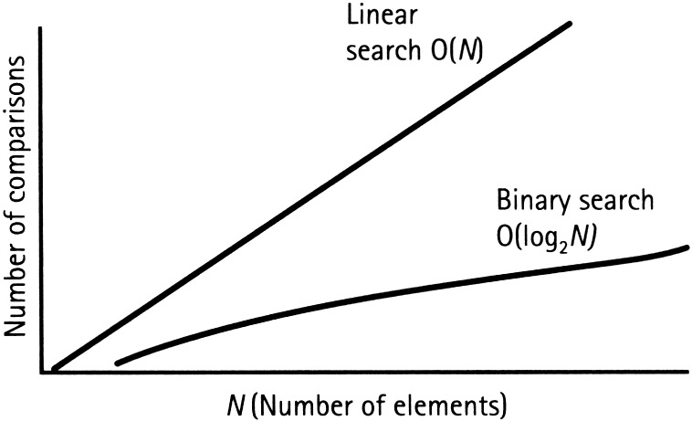
Binary Search
If your list contains N elements, and the target element is at a random position in the list then on average it will take log₂N checks to find your element. To give you a sense of this speedup, the log₂1024 = 10 (since 2¹⁰ = 1024). This means that binary search runs 10x faster on sorted lists of length ~1K. The notation for this algorithm is O(log N)

Slide 22
Comparing Sequential Search vs Binary Search (These are "worst case" numbers.)
N | Sequential Search Comparison Count | Binary Search Comparison Count
2 | 2 | 2
4 | 4 | 3
8 | 8 | 4
16 | 16 | 5
100 | 100 | 7

Slide 23
Exercise: BinarySearch
Today, you're going to write your own implementation of binary search.
Implement the binarySearch method in the BinarySearch Replit
Also, implement an input loop that asks the user for a word, and searches for the word using binarySearch.
Take care – this algorithm is reaaaaally easy to get mostly right but still wrong...
Towards the end of class, we'll review a solution together.
Although the basic idea of binary search is comparatively straightforward, the details can be surprisingly tricky
— Donald Knuth^{[2]}

Slide 24
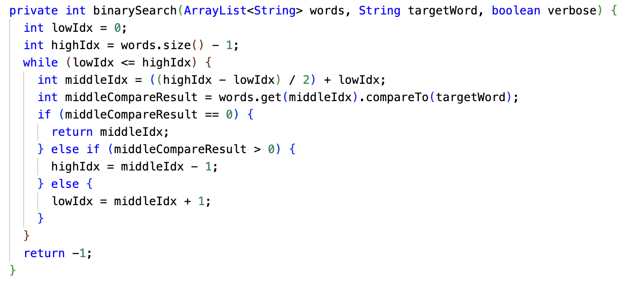
Chris's solution

Slide 25
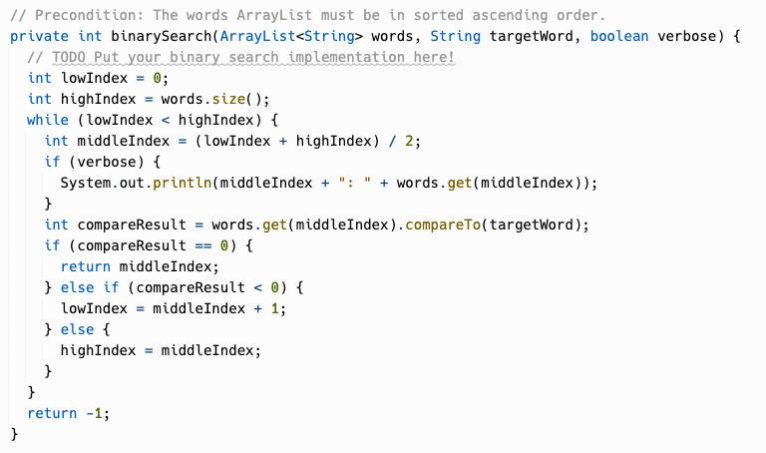
Gary's solution

